Slide 1


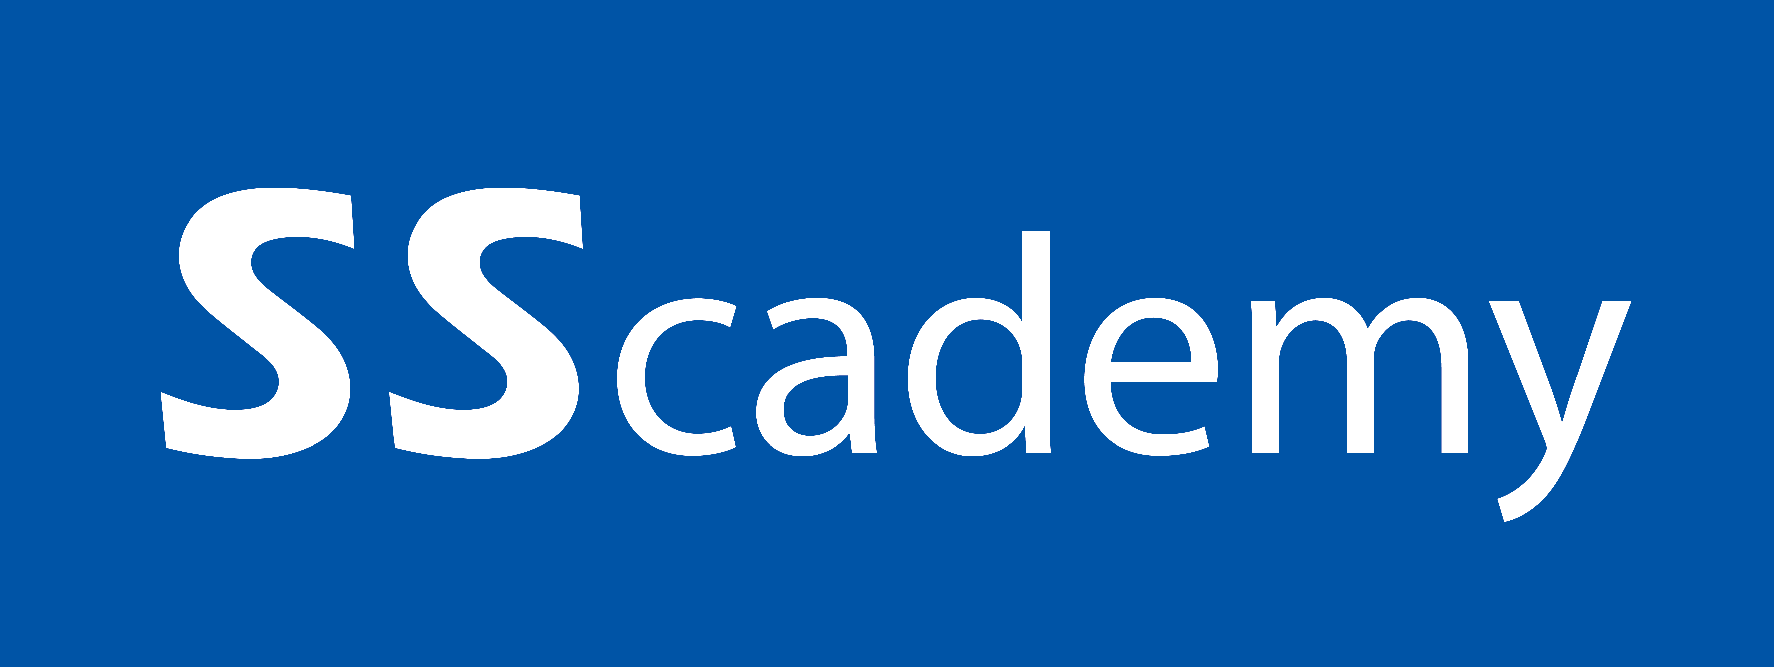

JENKINS
www.sscademy.com +918296373001

Slide 2
Code, Build, Test and Push
PUSH
TEST LOCALLY
CODE
BUILD

Slide 3
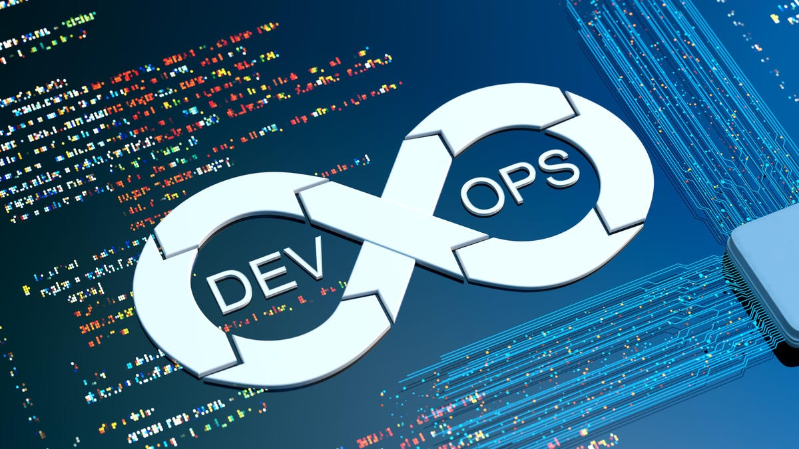

Code Merge but Not Integrated
Developers keep merging the code to VCS several times a day. All the code collected from different
Developers would have generated conflicts and bugs.
Code Merged from long time when built throughs Conflicts, Bugs and Errors.
All these conflicts, bugs and errors need to be resolved , which takes a very long time and halts
Development.
www.sscademy.com

Slide 4
Contineous Integration
DEVELOPERS
VCS
FETCH
BUILD
TEST
NOTIFY
DEVELOPERS
www.sscademy.com

Slide 5
Contineous Integration
Developers create some code and upload it into some version controlling system like Git. Jenkins will immediately download that code and this is called continuous download.
The code downloaded in the previous stage has to converted into a setup file commonly know as artifact. This artifact can be in the format of jar,war,ear file etc. To trigger this build process Jenkins uses build tools like Maven, Gradel, Msbuild etc. This stage is called continuous build
The artifact in the previous stage has to deployed into the testing environment. This testing servers might be running on some application servers like tomcat, WebLogic etc. Once it is deployed here it become available to the testers. This is called continuous deployment.
Testers create automation test scripts using tools like Selenium, Codedui etc. Jenkins now executes these automation testing scripts and check if the application is working correctly or no. If it not working Jenkins will send email notifications to the corresponding team members. Developers will fix the defects and upload the modified code into git, Jenkins will again start from stage 1
www.sscademy.com

Slide 6
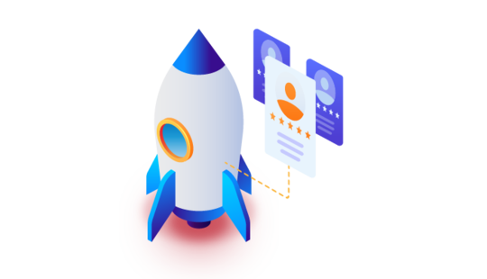
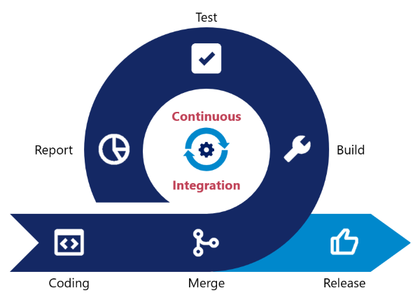
Contineous Delivery
If testing passes Jenkins will deploy the artifact into the production servers form where the end user or client can start accessing it. This is called continuous delivery
www.sscademy.com

Slide 7
Jenkins Installation
Step 1: Go to the installation URL and select Installation for Linux
https://www.jenkins.io/doc/book/installing/
Step 2: Select Ubuntu/Debian & Copy the script
Step 3: Go to AWS cloud, Launch Ubuntu 20.04 LTS instance, select t2.micro (change to small if you face slowness, create key pair, Create security group, allow inbound role ssh from anywhere, allow 8080 from anywhere and paste the script in the user data field
Step 4: Once instance is created use its public IP & port 8080 to access the Jenkins server
E.g: 48.19.222.10:8080
Step 5: Login to Jenkins server using ssh & .pem key and go to the password file suggested in the Jenkins server URL
Step 6: You can check the userdata using this command:
curl http://169.254.169.254/latest/user-data
www.sscademy.com

Slide 8
Jenkins Installation
Step 7: Check if Jenkins is running
systemctl status Jenkins
Step 8: Check the password using below command
cat /var/lib/Jenkins/secrets/initialAdminPassword
Step 9: Copy the password and paste it in the Jenkins server URL
Step 10: Click on Suggested plug ins
Step 11: Enter username and password for Jenkins dashboard
www.sscademy.com

Slide 9
Jobs in Jenkins
Freestyle VS Pipeline As a code
Freestyle
Graphical Jobs
Learning, understanding & exploring Jenkins
Not recommended in Real time now
Pipeline As a Code
Pipeline created in groovy
Recommended now
www.sscademy.com

Slide 10
QUESTION & ANSWERS
www.sscademy.com

Slide 11



Contact us for more details
sales@sscademy.com
sales@sscademy.com
www.sscademy.com
+ 918296373001

